Slide 1
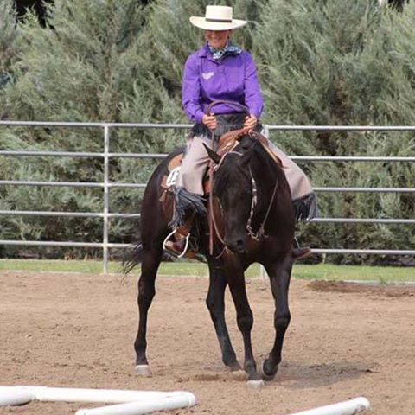
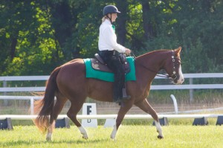
Western/Cowboy Dressage
Clinic/Lessons
Provided by :
Vickie Wancho
FIRST LESSON:
Friday, NOV 13th
6:00 PM
Sign up by TEXTING or CALLING Sue Behringer: 847-736-8665
Pony Club or Horsemasters Members: $35 (one hour lesson)
Non-members : $40

